Slide 1
Towards falsifiable interpretability research
Ari Morcos
CVPR 2021 Tutorial on Interpretable ML for CV
Matthew Leavitt
Former Facebook AI Resident

Slide 2
Interpretability can be viewed as building human intuition and understanding for complex “black box” models
Intuition is critical for understanding, but unverified intuition can be misleading and lead us astray
Notes:
Lead in to popper: “In order to verify an intuition, it must be falsifiable, as eloquently put by Karl Popper 60 years ago…”

Slide 3
In so far as a scientific statement speaks about reality, it must be falsifiable; and in so far as it is not falsifiable, it does not speak about reality.
Karl Popper
The Logic of Scientific Discovery, 1959
Notes:
“In many ways, this statement might seem trite, of course science should be falsifiable, but making truly falsifiable statements is often easier said than done, and many intuitions which seem rock solid can actually be very misleading. As an example, consider the beloved Gaussian…

Slide 4
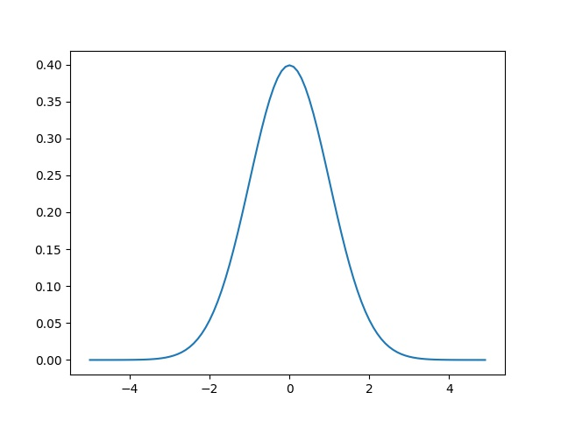
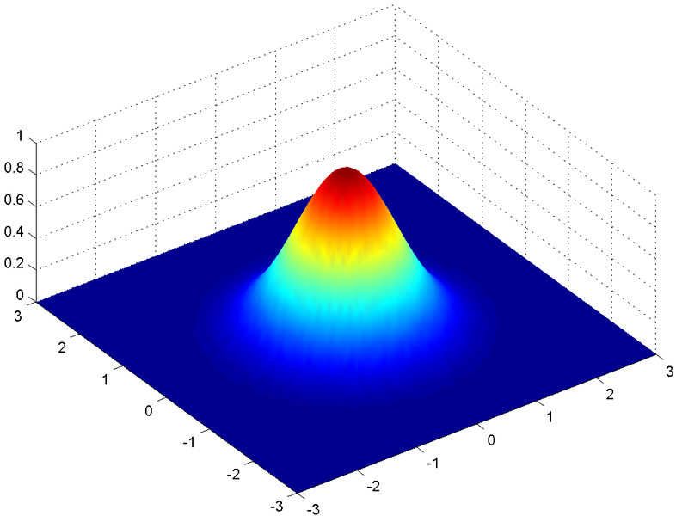

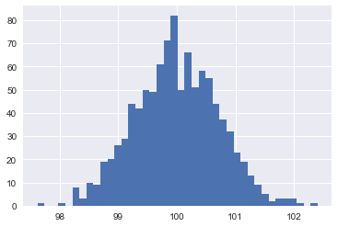
On the perils of unverified intuition – the Gaussian distribution in high-dimensional spaces
1-dimensional
Gaussian
2-dimensional
Gaussian
10k-dimensional
Gaussian
Sample norm
For an accessible description, see Ferenc Huszár’s blog on the topic:
https://www.inference.vc/high-dimensional-gaussian-distributions-are-soap-bubble/

Slide 5
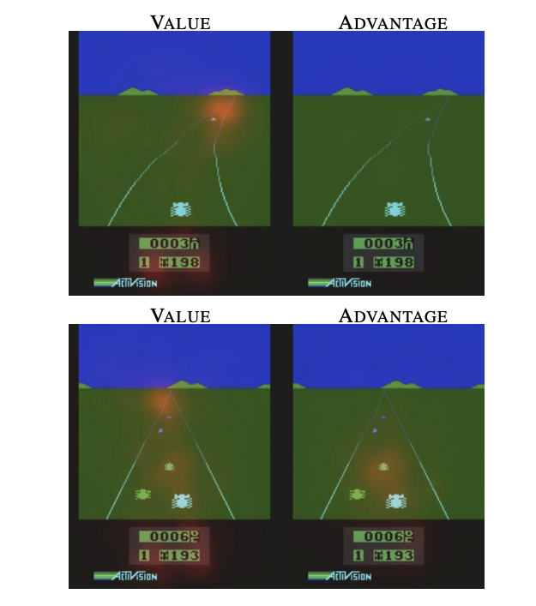
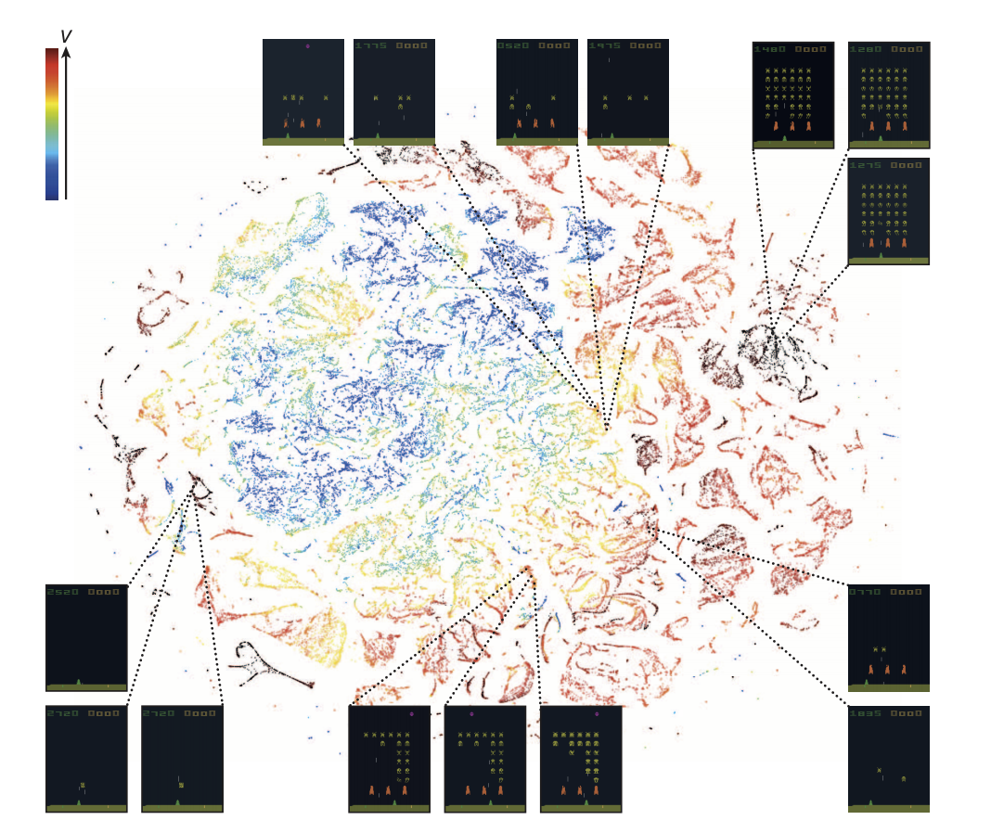
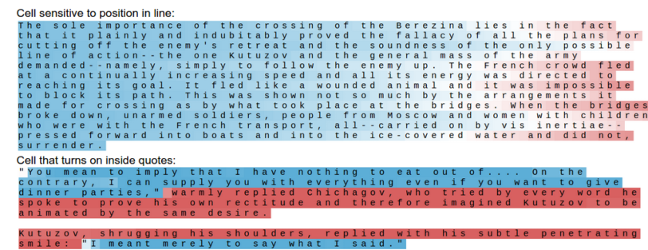
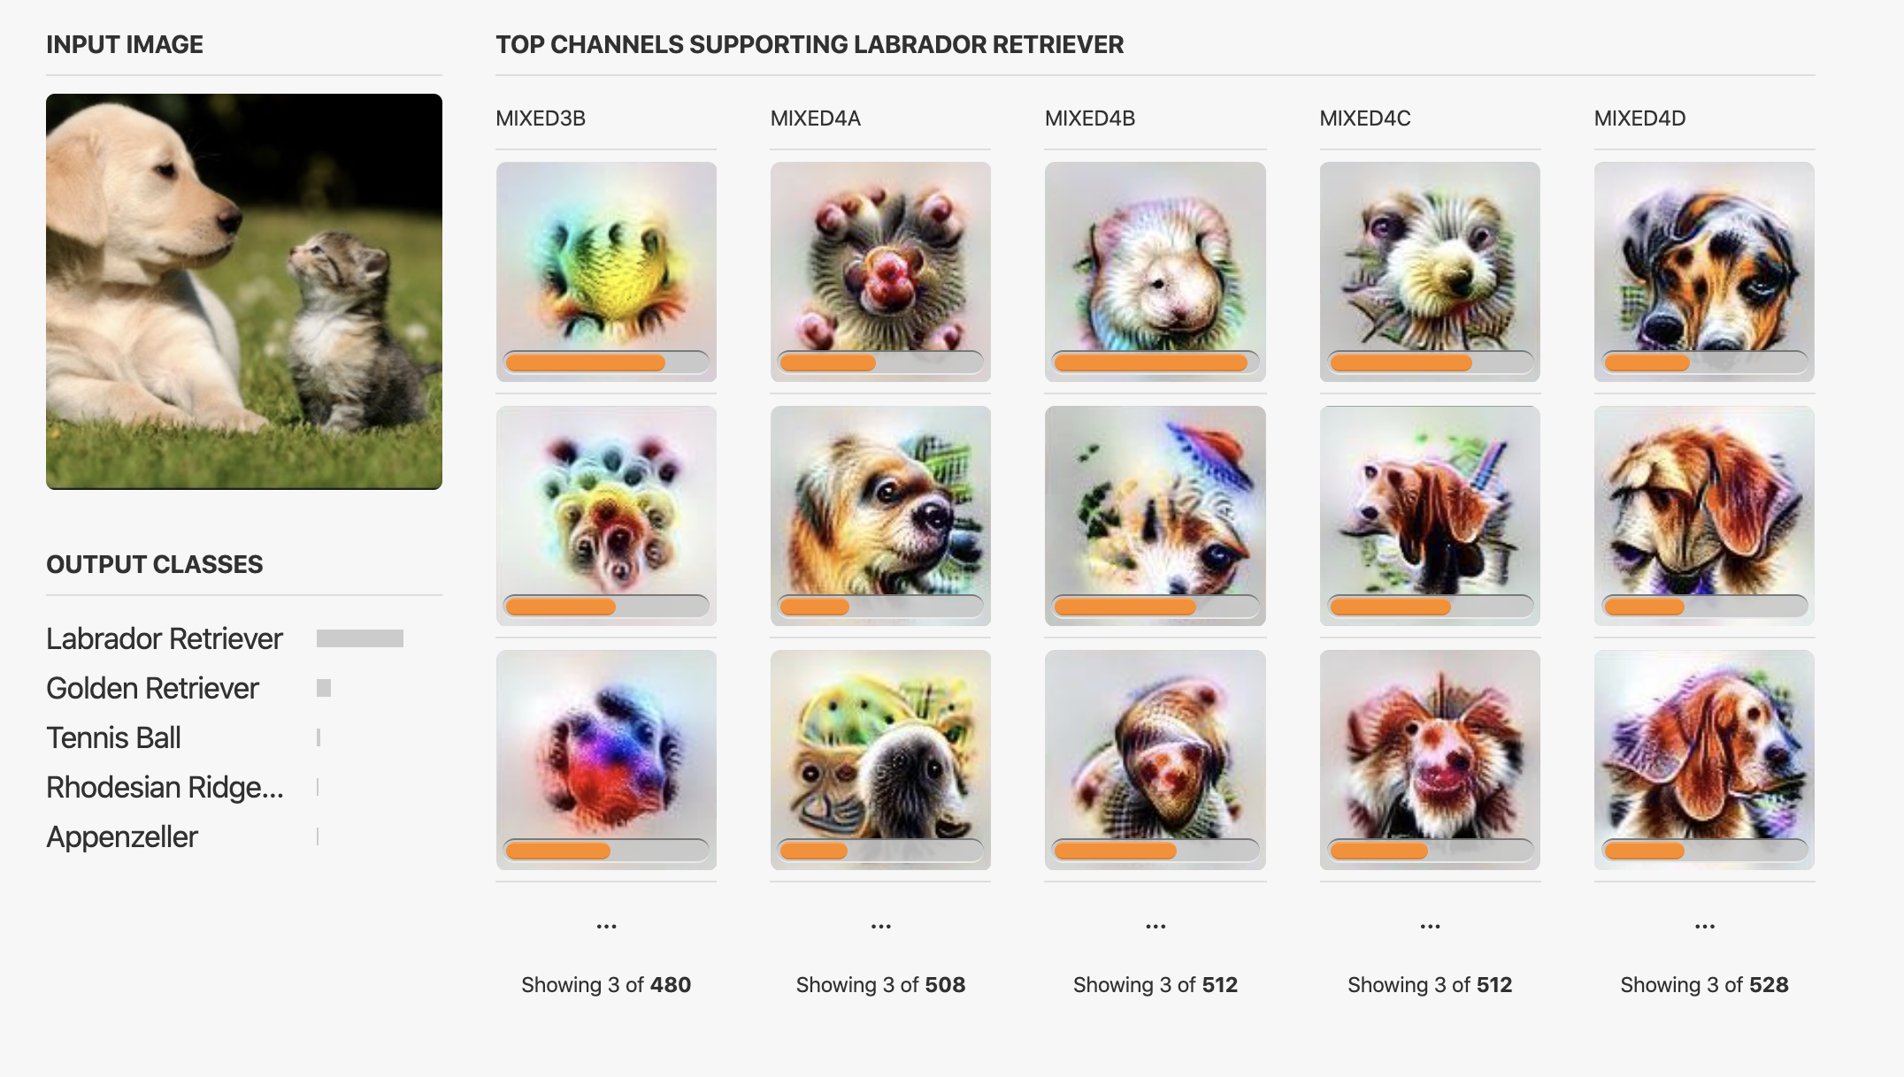
Building intuition with ML visualizations
t-SNE
(van der Maaten and Hinton, JMLR 2008)
Saliency
Single neuron visualization
Karpathy et al., 2015
Mnih et al., Nature 2015
Wang et al., ICML 2016
Olah et al., Distill 2017

Slide 6
Outline
Impediments to falsifiable interpretability research
Case study 1: The misdirection of saliency
Case study 2: Understanding networks through easy-to-interpret neurons
Building better hypotheses
Goal
Build intuition so that we can better understand DNNs, but ensure that this intuition is grounded in rigorous, falsifiable experiments

Slide 7
Impediments to falsifiable interpretability research
Underemphasis on clear, specific, testable, and most critically, falsifiable hypotheses
Interpretability methods are often not verified as being important for DNN function
The double-edged sword of visualization
Visualization can be extremely helpful for building understanding, especially during exploration
However, it can also lead to strong feelings of comprehension regardless of how accurate the visualization may be, especially since visualizations often feature individual examples

Slide 8
Impediments to falsifiable interpretability research - continued
Lack of quantification
Relates directly to lack of verification and the double-edged sword of visualization
Especially important in deep learning where similar models can have dramatically different properties across different hyperparameters
Without quantification, visualization can serve as a Rorschach test for a researcher
For interpretability methods designed with the intent to provide actionable explanations to humans, it is critical to conduct controlled experiments to evaluate the utility of these methods

Slide 9
Case study 1:
The misdirection of saliency

Slide 10
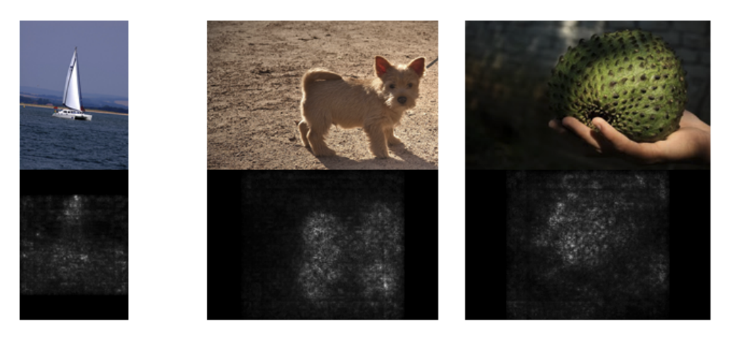
Introduction to saliency/feature attribution visualizations
Which portions of the input are most responsible for a given classification decision?
Typically based on some form of the gradient of a given output wrt the input
Simonyan et al., ICLR Workshop 2013

Slide 11
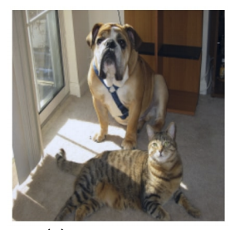
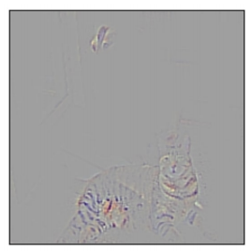
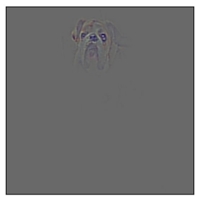
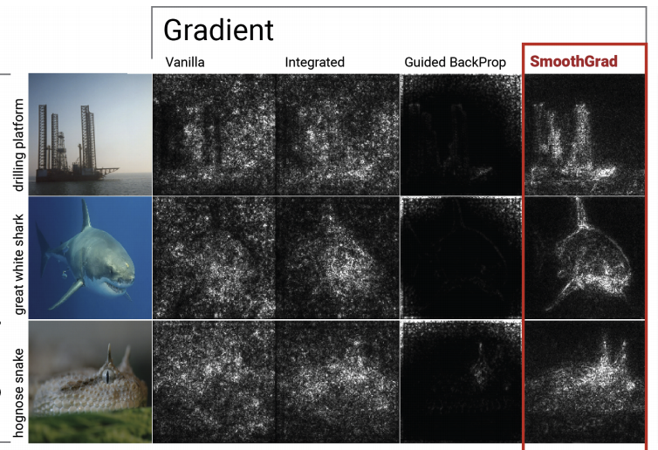
Improved saliency methods
Guided Grad-CAM
“Cat”
Guided Grad-CAM
“Dog”
Input image
Grad-CAM
(Selvaraju et al., ICCV 2017)
SmoothGrad
(Smilkov et al., ICML Workshop on Visualization for DL 2017)

Slide 12
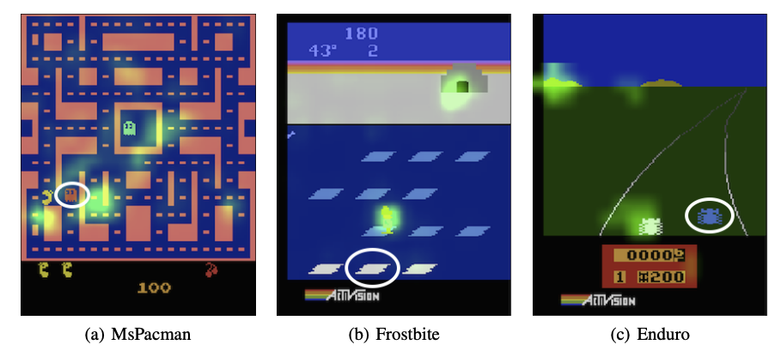
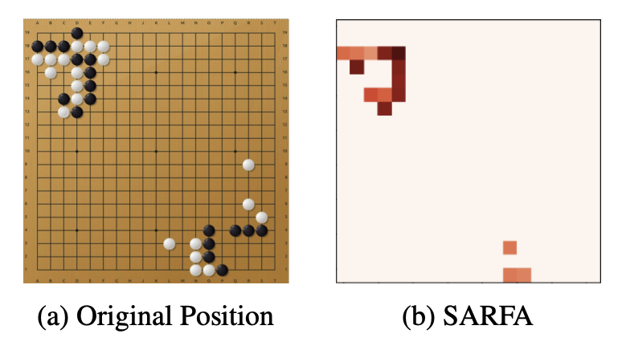
Saliency for model explainability in RL
Greydanus et al., ICML 2018
Puri et al., ICLR 2020

Slide 13
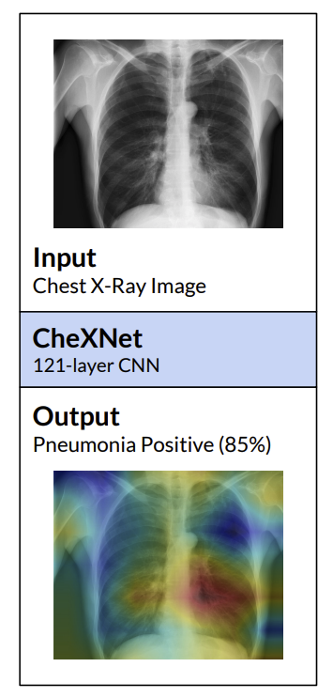
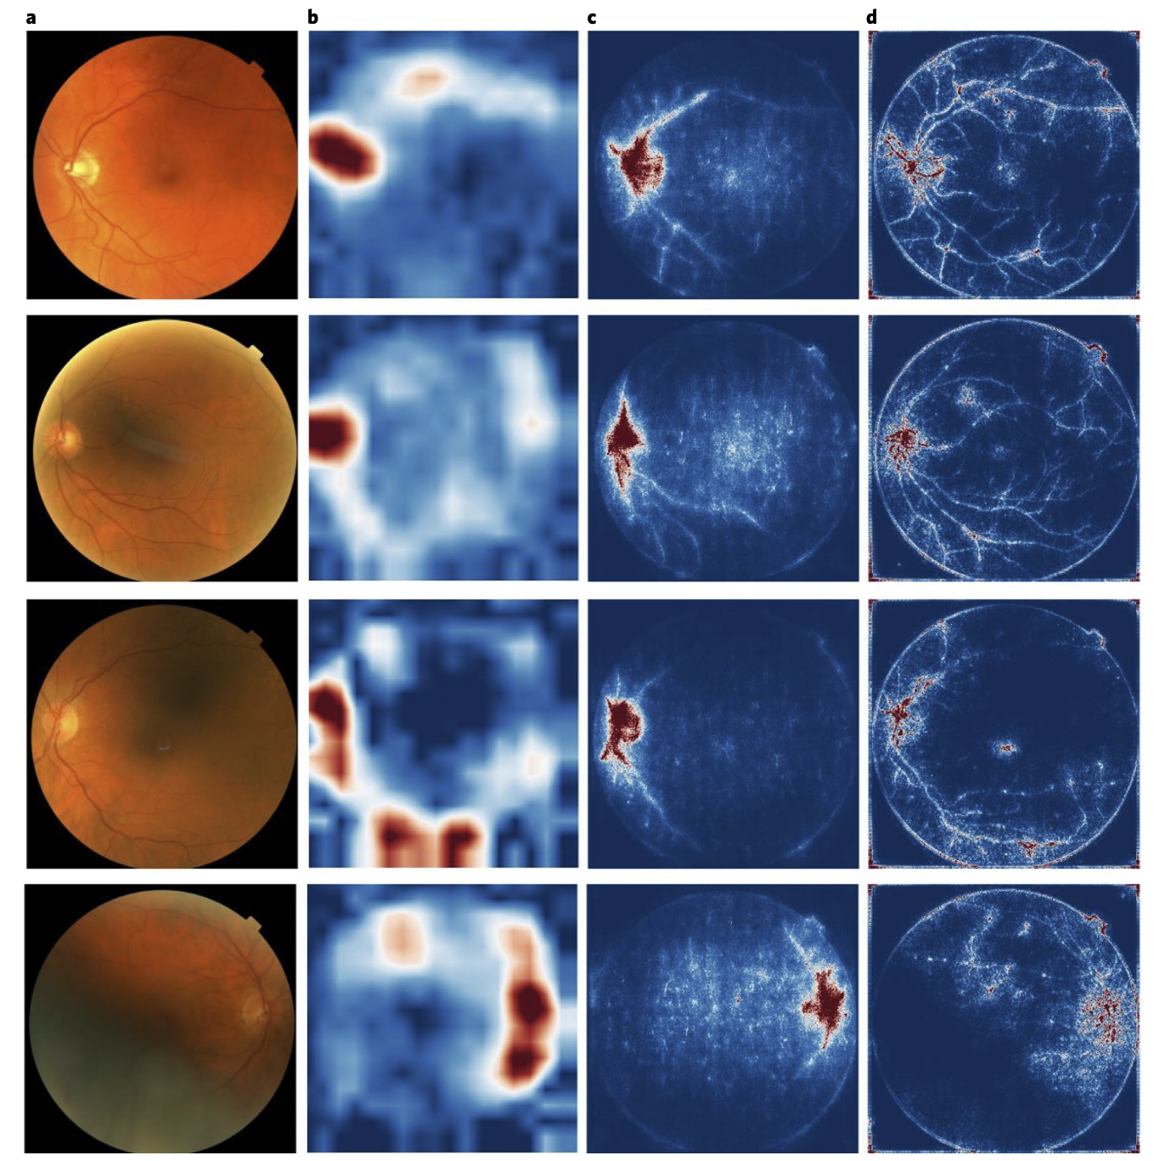
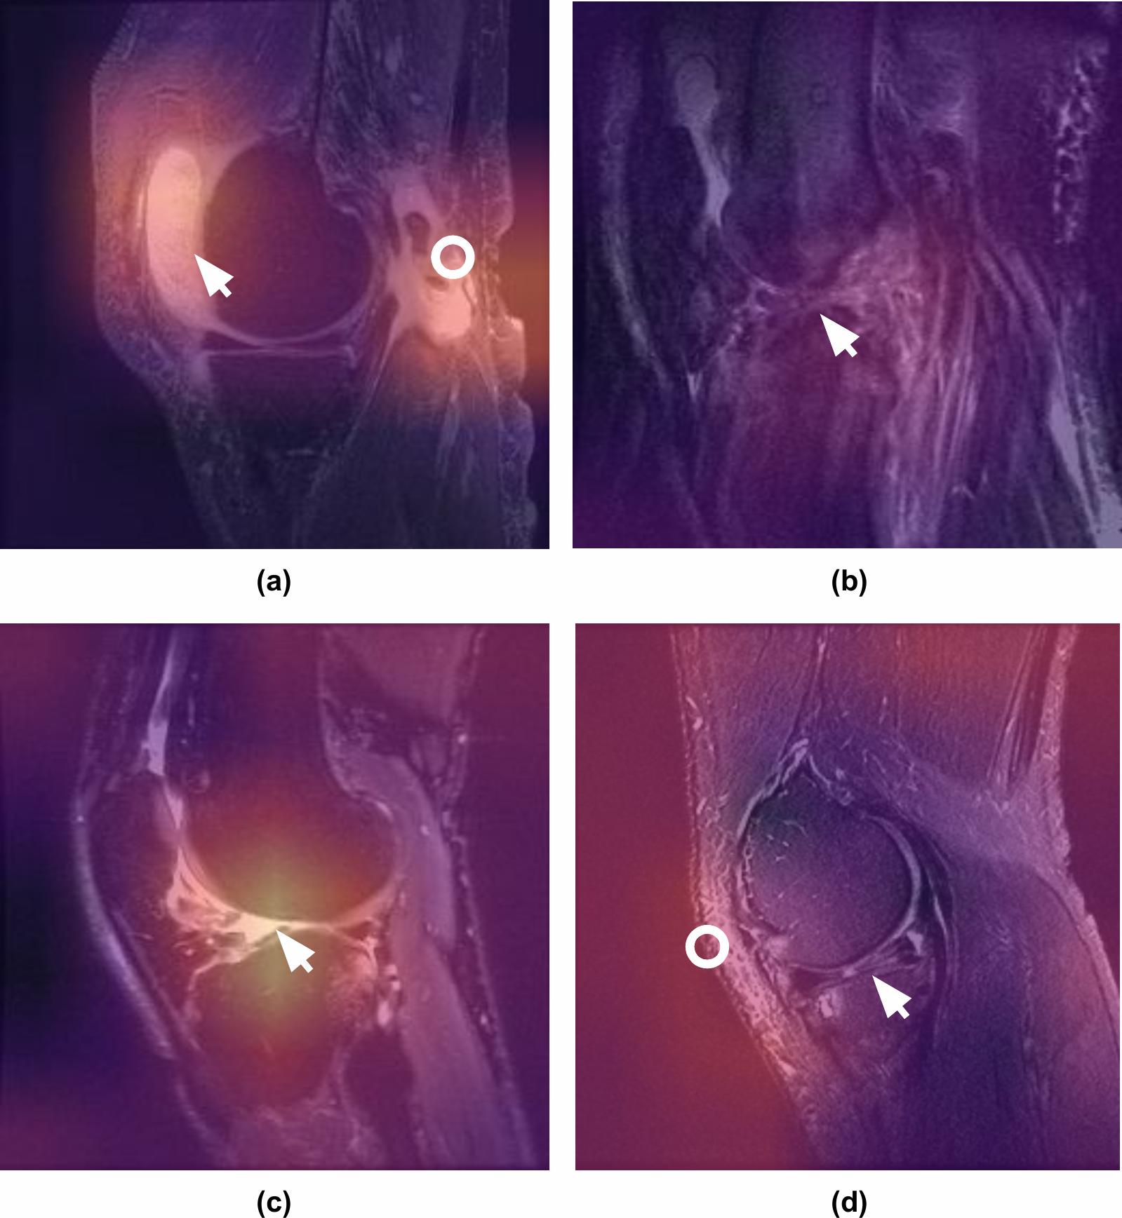
Saliency in medical imaging
Pneumonia detection from chest X-Rays
Interpretation of knee MRIs
Detecting anaemia from retinal fundus images
Rajpurkar et al., 2017
Bien et al., PLOS Medicine 2018
Mitani et al., Nat Biomed Eng 2020

Slide 14
Insights from integrated gradients: what axioms should saliency methods satisfy?
Axiom 1: Sensitivity
If two inputs differ in only one feature but result in different predictions, the differing feature should have non-zero saliency
Standard gradient-based saliency fails this axiom because ReLUs can result in zero gradient despite different inputs if, for example, the pre-ReLU activation is less than 0
Axiom 2: Implementation invariance
If two networks are functionally equivalent (produce identical output in response to all inputs), their saliency maps should also be identical
In other words, the saliency map should be invariant to the implementation of the function
Standard gradient-based saliency satisfies this condition, but many more complicated saliency methods do not
Sundararajan et al., ICML 2017

Slide 15
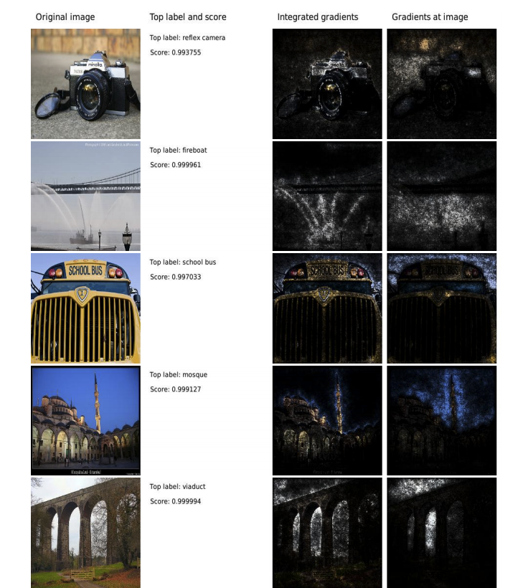
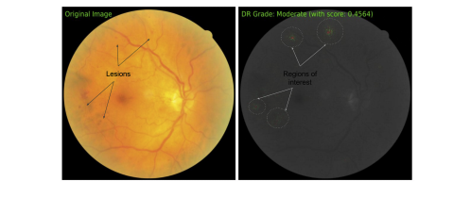
Insights from integrated gradients: what axioms should saliency methods satisfy?
Sundararajan et al., ICML 2017

Slide 16
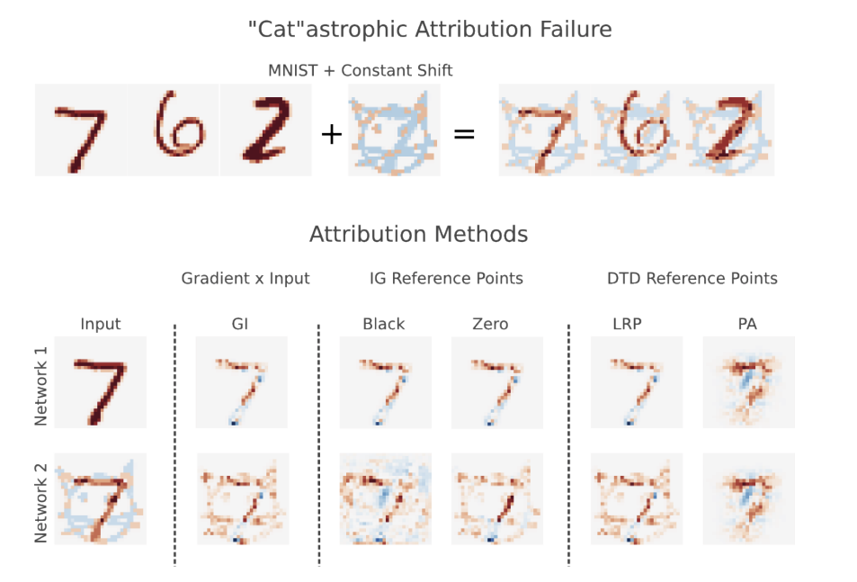
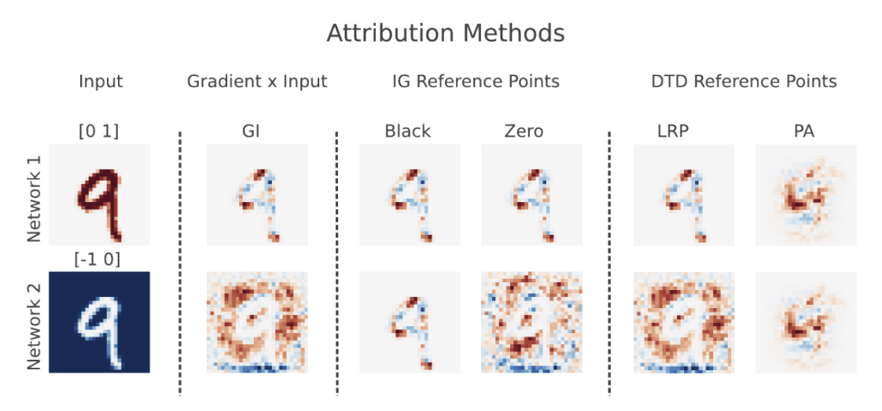
Many saliency methods are not invariant to input transformations
Axiom: input invariance
If a constant shift is applied to all inputs, the attribution method should not change
Kindermans et al., 2019

Slide 17
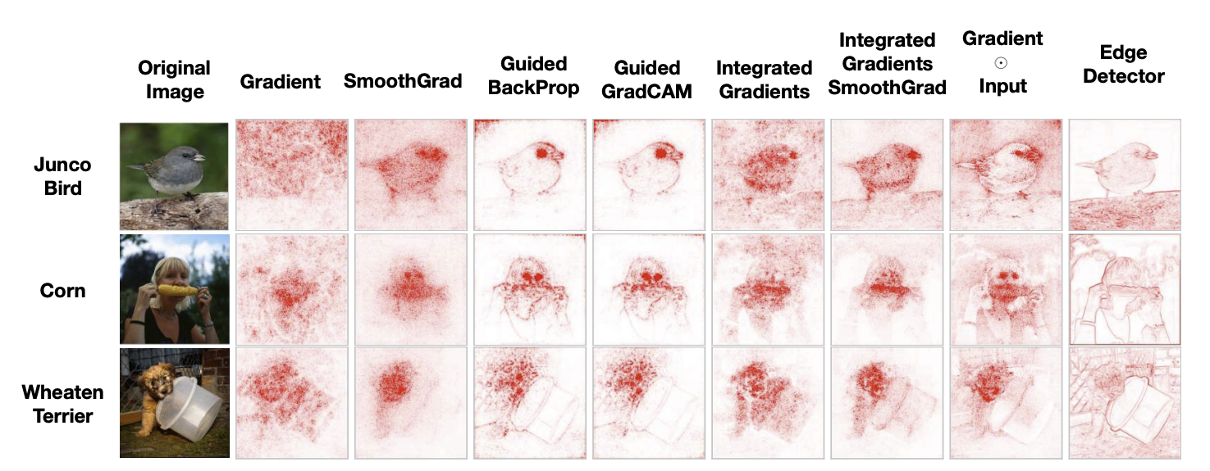
Many saliency methods produce maps which are very similar to edge detectors
Adebayo et al., NeurIPS 2018

Slide 18
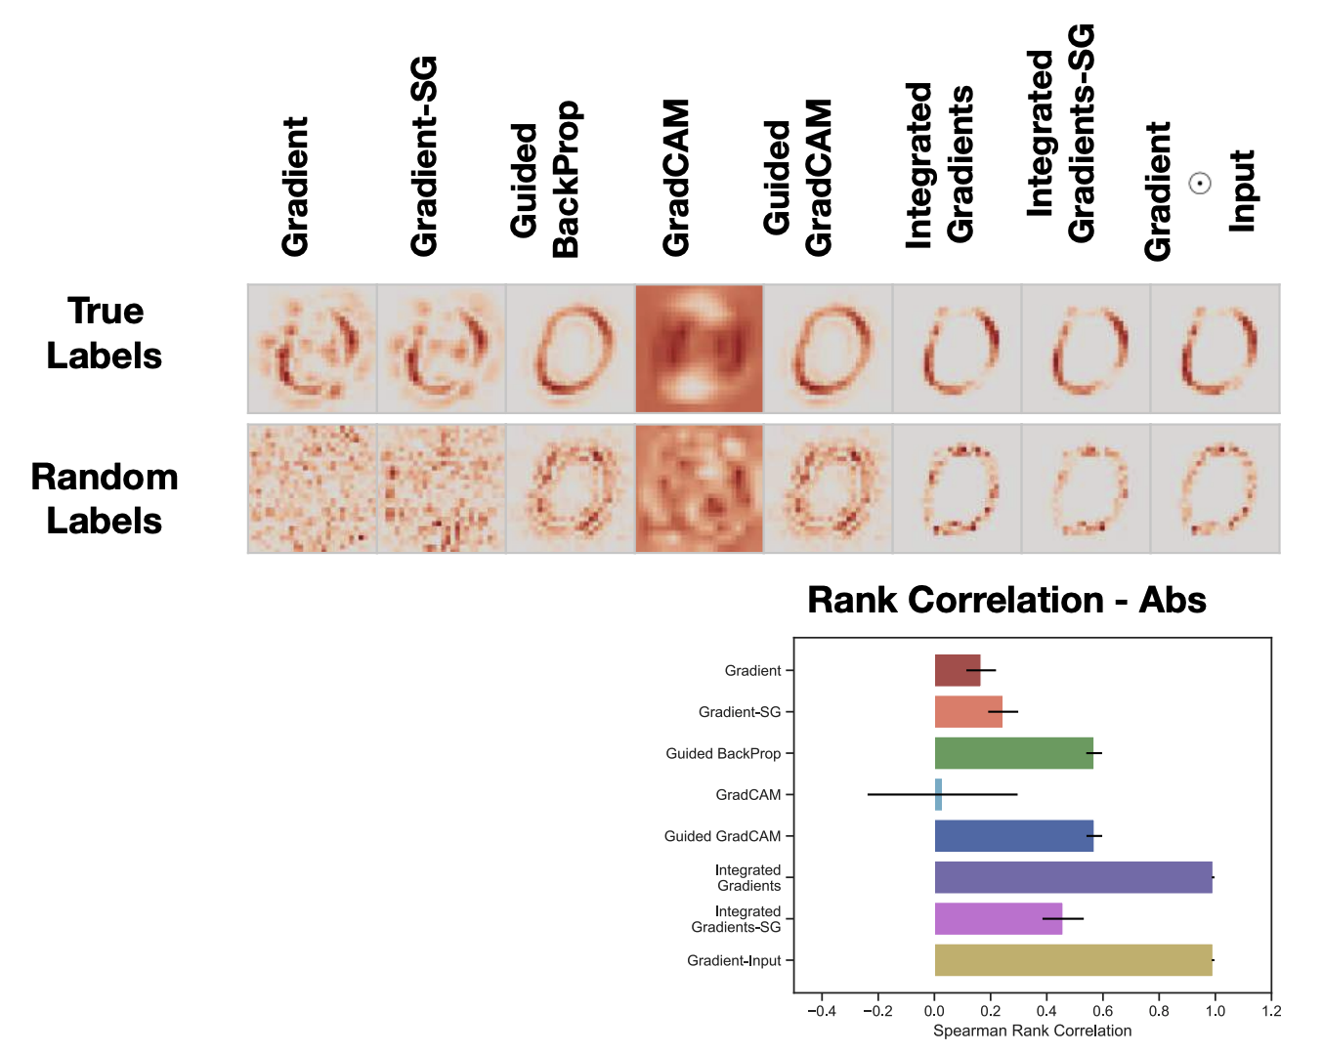
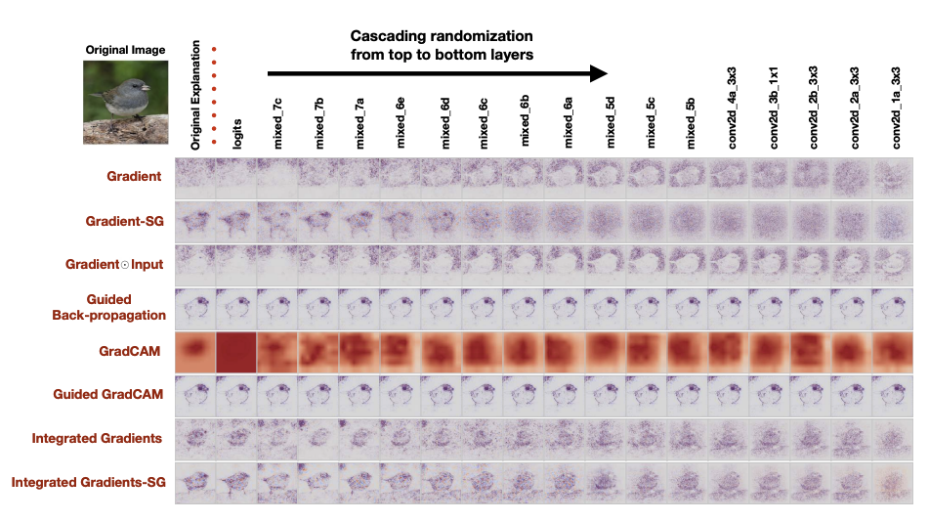
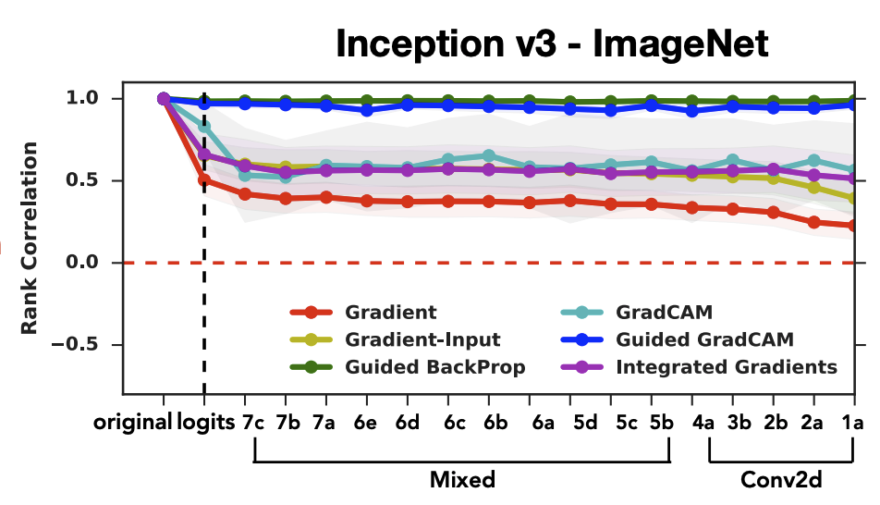
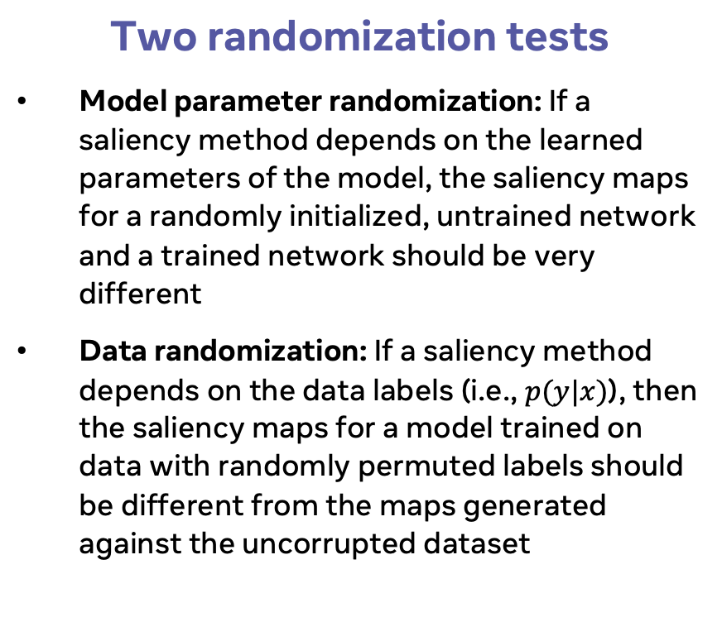
Many saliency methods fail randomization sanity checks
Two randomization tests
Model parameter randomization: If a saliency method depends on the learned parameters of the model, the saliency maps for a randomly initialized, untrained network and a trained network should be very different
Data randomization: If a saliency method depends on the data labels (i.e., $p(y|x)$), then the saliency maps for a model trained on data with randomly permuted labels should be different from the maps generated against the uncorrupted dataset
Adebayo et al., NeurIPS 2018

Slide 19
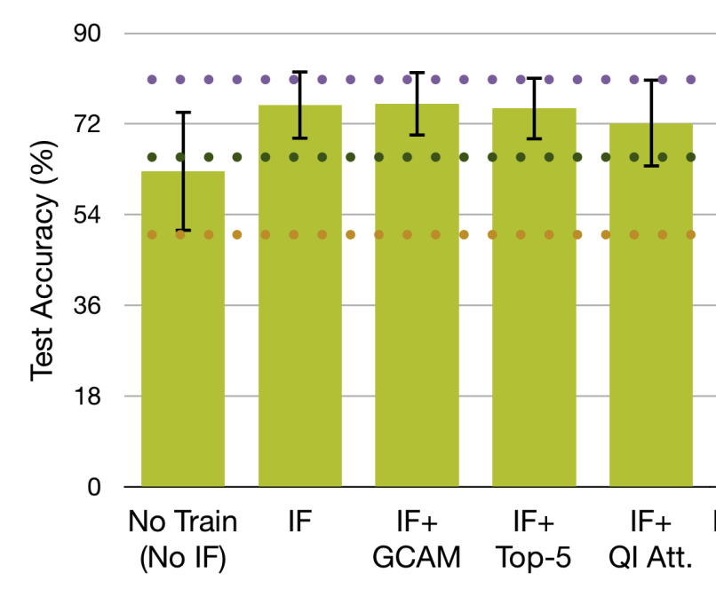
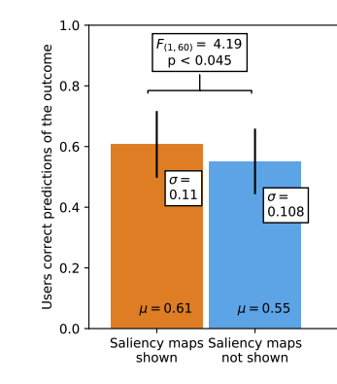
Do saliency maps help humans better predict DNN outputs?
Chandrasekaran et al., CVPR 2017
Alqaraawi et al., IUI 2020

Slide 20
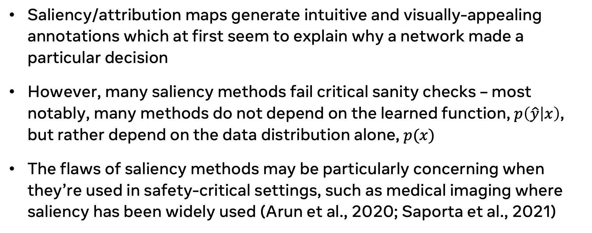
Takeaways
Saliency/attribution maps generate intuitive and visually-appealing annotations which at first seem to explain why a network made a particular decision
However, many saliency methods fail critical sanity checks – most notably, many methods do not depend on the learned function, $p\left(\hat{y} | x\right)$, but rather depend on the data distribution alone, $p(x)$
The flaws of saliency methods may be particularly concerning when they’re used in safety-critical settings, such as medical imaging where saliency has been widely used (Arun et al., 2020; Saporta et al., 2021)

Slide 21
Case study 2:
Understanding networks through easy-to-interpret neurons

Slide 22
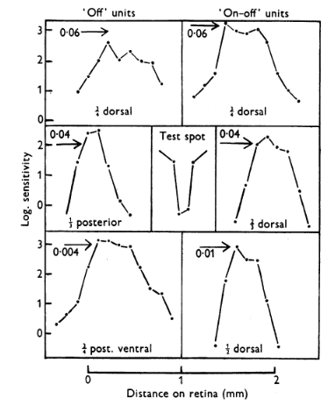
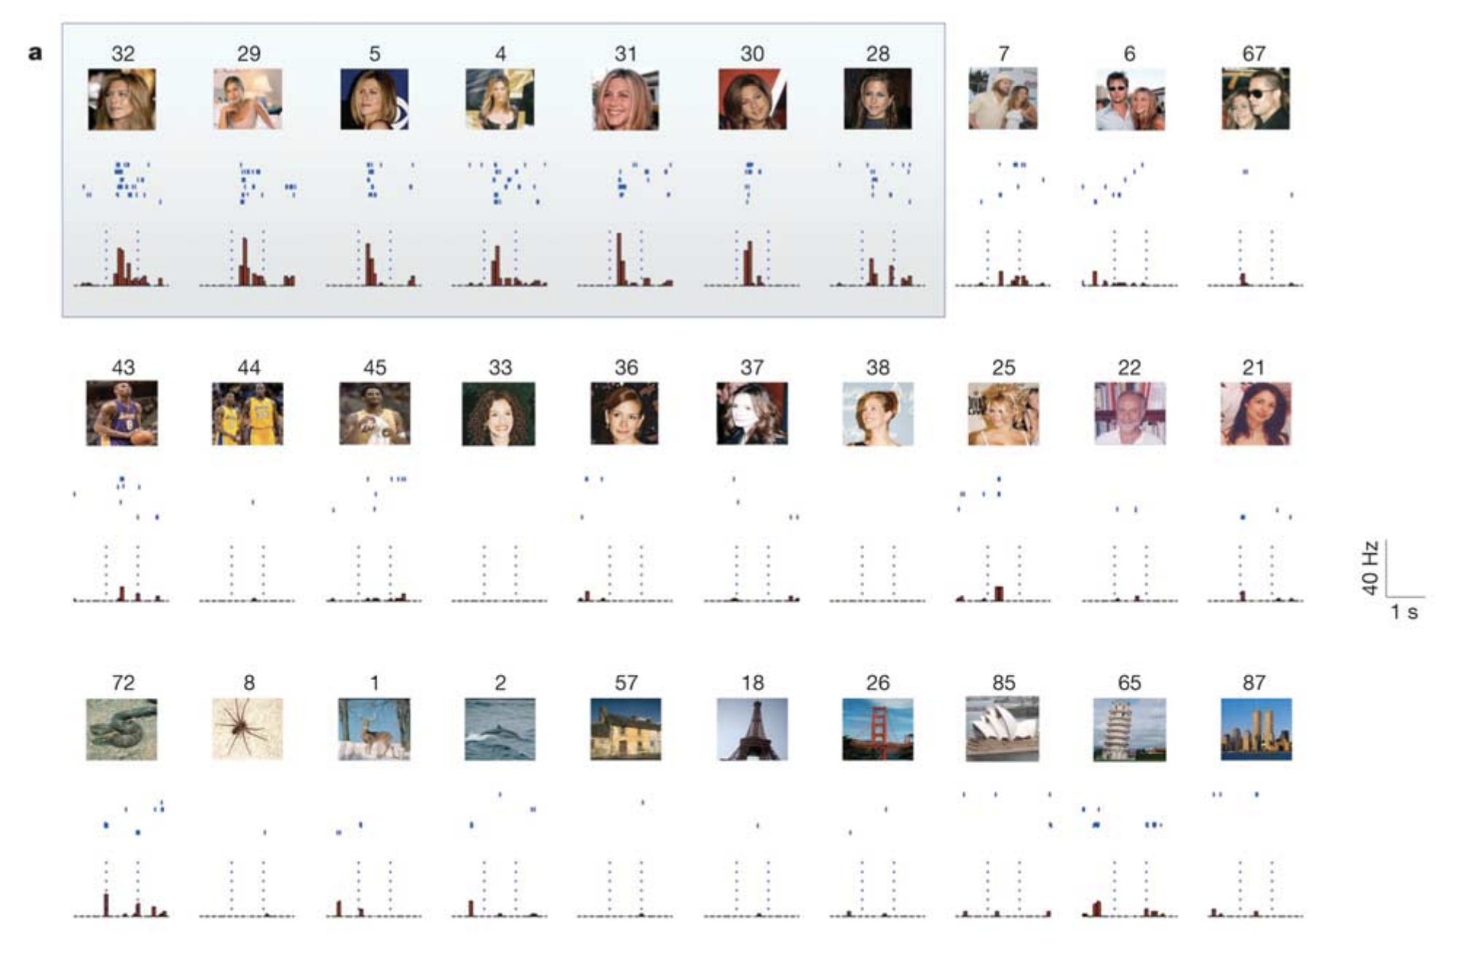
Selectivity for understanding the nervous system
Barlow, J. Physiol. 1953
Quian Quiroga et al., Nature 2005

Slide 23
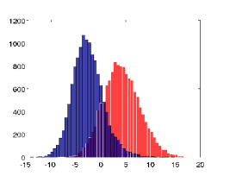
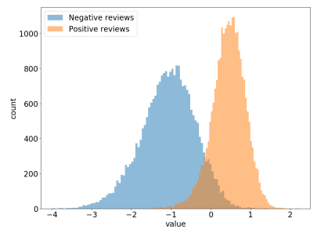
Selectivity for understanding deep networks
“Face” neurons
Text-selective neurons
Sentiment neuron
Le et al., ICML 2011
Karpathy et al., 2016
Radford et al., 2017

Slide 24
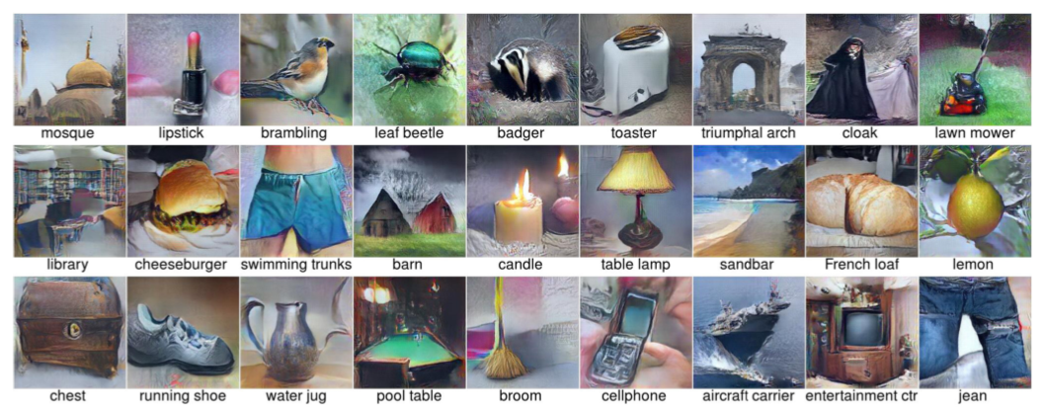
Activation maximization for understanding deep learning
Channel attribution
Optimized for CaffeNet output neurons
Olah et al., Distill 2018
Nguyen et al., NIPS 2016

Slide 25
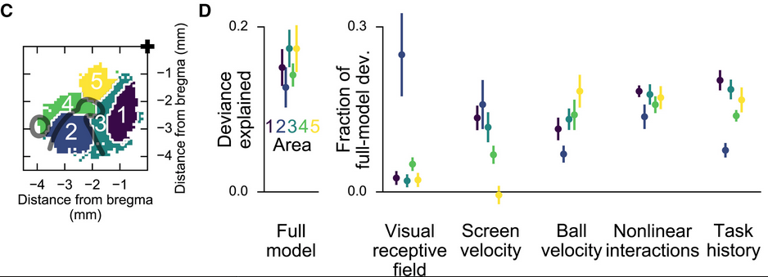
A shift in neuroscience from single units to populations
Minderer et al., Neuron 2019
Non-selective neurons can contribute to population coding
Macaque prefrontal cortex (Leavitt et al., 2017); mouse visual cortex (Zylberberg, 2017); rat auditory and frontal cortex (Insanally et al., 2019)
Movement towards population-level phenomena for characterizing neural systems (Shenoy et al.,2013; Raposo et al., 2014; Fusi et al., 2016; Morcos and Harvey, 2016; Pruszynski and Zylberberg,2019; Heeger and Mackey, 2019; Saxena and Cunningham, 2019)

Slide 26
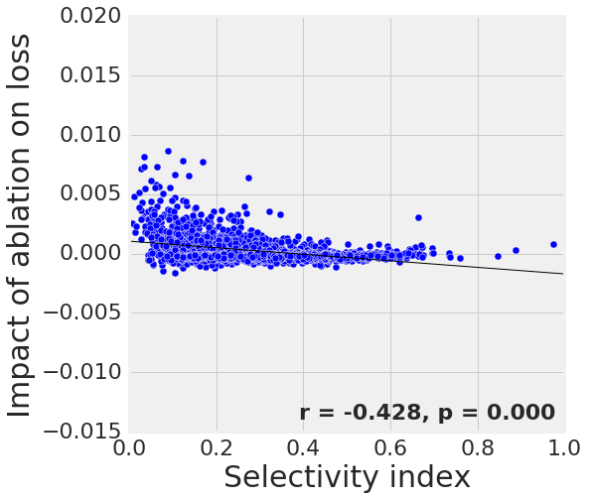
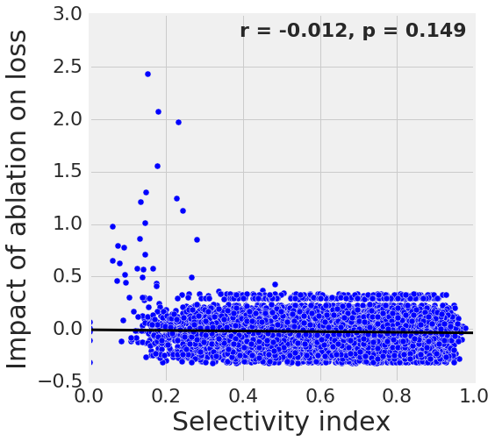
Class selectivity is a poor predictor of unit importance
The previous studies showed the existence of individually interpretable single units, but did not test whether these units causally lead to better performance
Performance
impairment
Δ loss
Δ loss
Performance
improvement
Low
selectivity
High
selectivity
Morcos et al., ICLR 2018

Slide 27
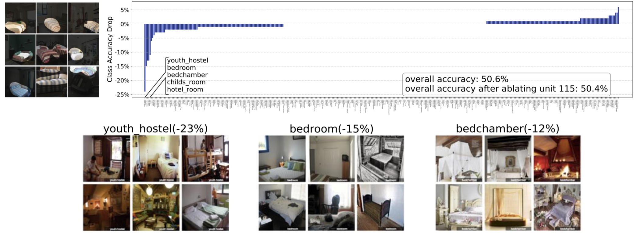
Ablating selective units causes class-specific deficits
Zhou et al., 2018

Slide 28
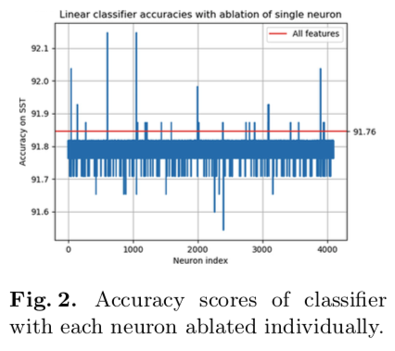
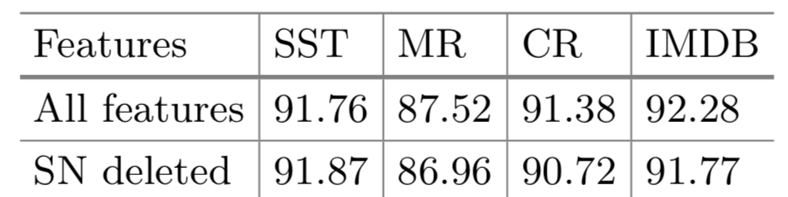
Ablating the sentiment neuron can improve performance
Donnelly and Roegiest, 2019

Slide 29
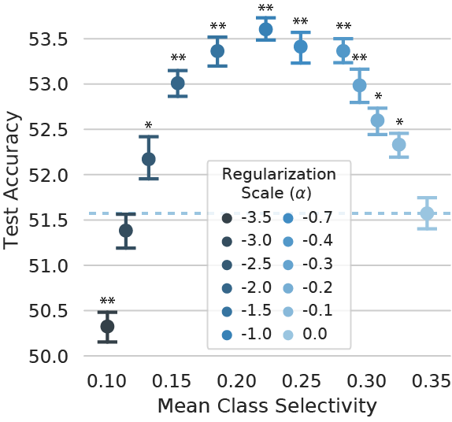
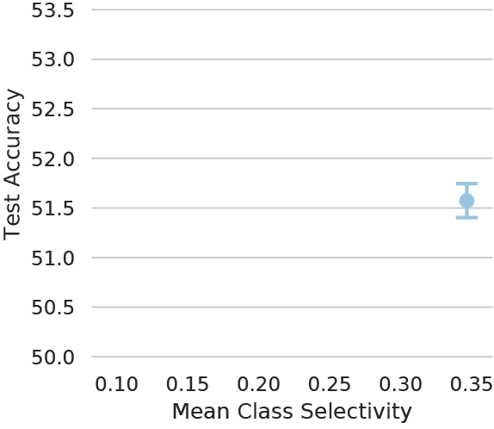
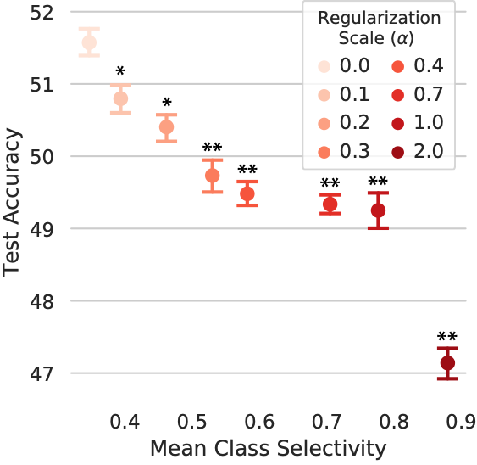
Class selectivity is neither sufficient nor strictly necessary for high accuracy
Leavitt and Morcos, ICLR 2021

Slide 30
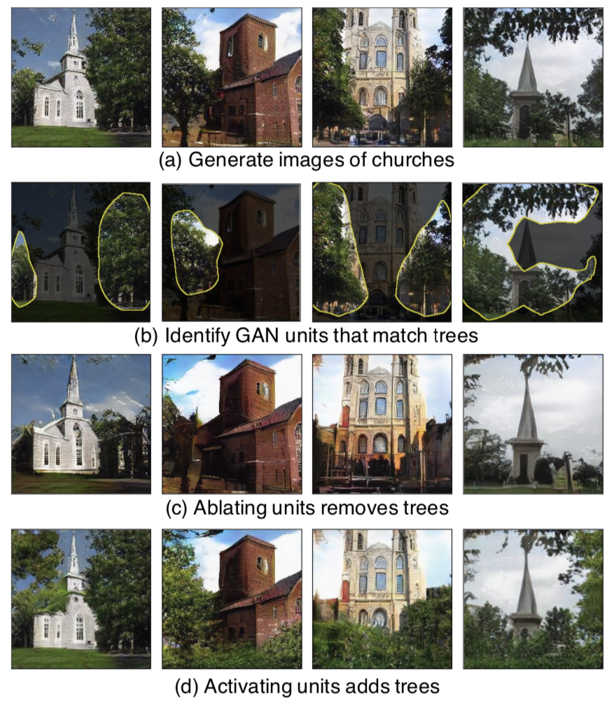
Individual interpretable units in generative models causally change function
Bau et al., ICLR 2019

Slide 31
Takeaways
The tractability of low-dimensional signals can encourage researchers to focus on the properties of individual units as representative of network behavior
Studies using single unit ablation, class selectivity regularization, and generative models show that the properties of single units do not reliably extrapolate to populations
Approaches for understanding networks should utilize functionally—ideally causally—relevant properties
Researchers should focus on properties that exist across neurons—distributed, high-dimensional representations—and develop tools to make these properties more tractable and accessible to intuition

Slide 32
Building better hypotheses

Slide 33
Building hypotheses of increasing strength – very weak
Hypothesis: Feature-selective neurons are the foundation of DNN function.
Pros
Cons
Not falsifiable
“Foundation” is vaguely defined; how do you test whether something is the “foundation of DNN function”?
No concept of a baseline for comparison

Slide 34
Building hypotheses of increasing strength – weak
Hypothesis: If feature selectivity is important for DNN function, then we should find feature-selective
neurons.
Pros
Cons
Is falsifiable! If there are no feature-selective neurons, this hypothesis has been proven false
Proving the non-existence of something is often challenging. What if one just didn’t use the right method to look?
Unclear what we should expect by chance: how many feature-selective neurons would we expect to occur randomly?
The presence of feature-selective neurons does not necessarily imply their functional importance

Slide 35
Building hypotheses of increasing strength – average
Hypothesis: If feature selectivity is necessary to maximize test accuracy, ablating feature-selective
single neurons should cause a decrease in test accuracy.
Pros
Cons
Falsifiable
Addresses causality – “necessary” is a much more concrete statement than “important” and leads to a specific experiment to test this hypothesis
No discussion of alternative possibilities
No discussion of baseline. What if ablating all individual neurons causes a decrease in test accuracy? Does that satisfy this hypothesis?

Slide 36
Building hypotheses of increasing strength – strong
Hypothesis: If feature selectivity in single neurons is necessary to maximize test accuracy, ablating selective neurons should cause a decrease in test accuracy proportional to the strength of the neuron’s feature selectivity. Alternatively, if networks rely more on feature selectivity across neurons than on feature selectivity in individual neurons, then zeroing activity in feature-selective directions (i.e. a linear combination of units that represents curves) that are not axis-aligned should cause a decrease in test accuracy that is proportional to the strength of feature selectivity and exceeds the decrease from ablating only single units.
Pros
Cons
Falsifiable
Makes clear testable predictions
Presents multiple competing hypotheses
Provides a baseline comparison (single units vs. non-axis-aligned linear combinations)
Verbose

Slide 37
Key takeaways
Intuition is critical, but be wary of unverified intuition, especially in interpretability!
4 key recommendations:
Make clear, specific, testable, and falsifiable hypotheses
Be wary of visualization! One’s skepticism should be proportional to the feeling of intuitiveness
Quantify wherever you can. An unquantifiable hypothesis risks being an unfalsifiable hypothesis.
Remember the “human” in “human explainability.” If a method aims to help humans understand DNNs, test this explicitly.

Slide 38
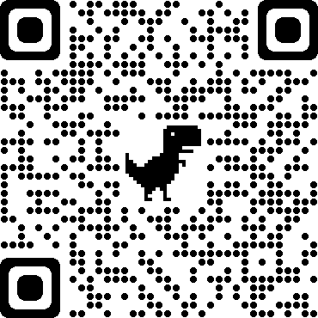
Thank you!
For more detail and references, see our position paper:
https://arxiv.org/abs/2010.12016
Matthew Leavitt
Former Facebook AI Resident

